Slide 1
Machine-learned prediction, synthesis, and characterization of Sb₂Se₃ pellets
Zachary Luscher, Chase Attermann, and Taha Alhashmi
Notes:
Taha

Slide 2
Goal
Machine learned material
Stable
New research
BiTe alternative
High figure of merit and Seebeck coefficient
Synthesis
Quick and efficient
Inexpensive
Reliable
Safe
Characterization
Crystallography and surface analysis
Thermoelectric
Notes:
Taha
Our goal is to verify our machine learning algorithm and synthesize a new novel thermoelectric material as an alternative to BiTe.
This material must be thermodynamically stable, have a high zT and Seebeck coefficient (S)
Want to
Quick, cheap synthesis, and no safety concerns if handled properly
Crystallographic and optical characterization to confirm material / cubic structure with XRD and SEM
Thermoelectric characterization with Keithley 2000 and Arduino Uno (Terminal logging) to analyze plausibility and then calculate Seebeck & zT

Slide 3
This Semester Plan:
Synthesize and or construct device and radiator according to optimized parameters for freezing water
Integrate spatial molecular properties [ X ]
Increase wire thickness for higher current.
More efficient heat sink [ X ]
Thermoelectric stacking [ X ]
Notes:
Taha

Slide 4
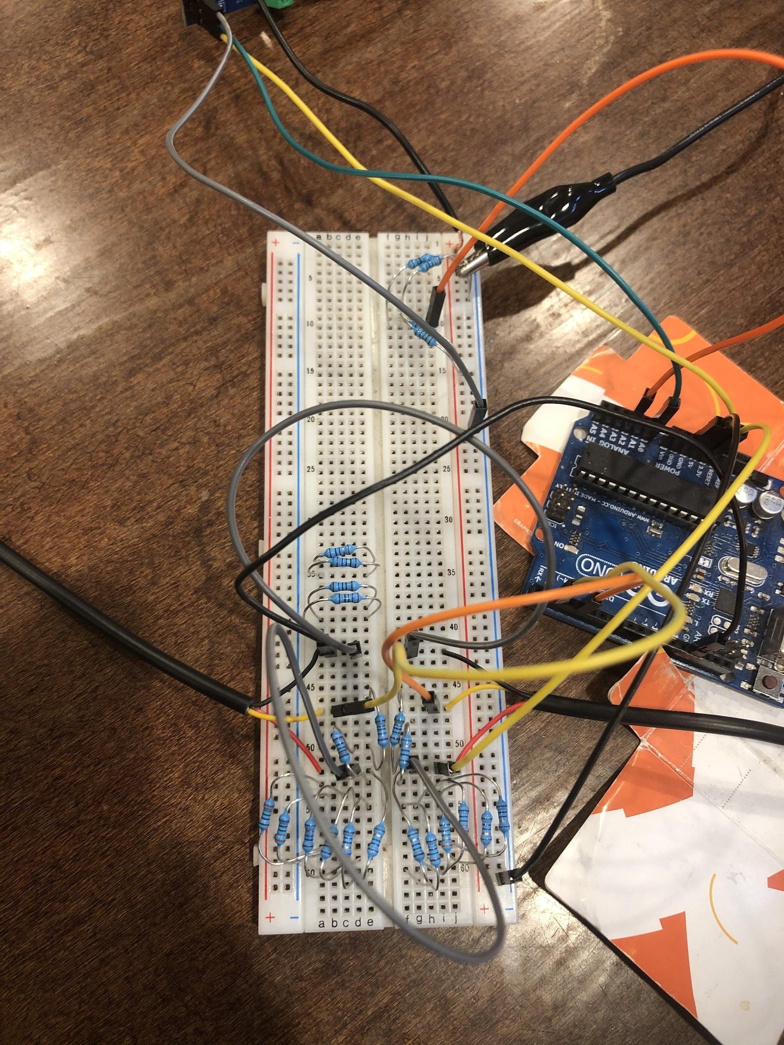
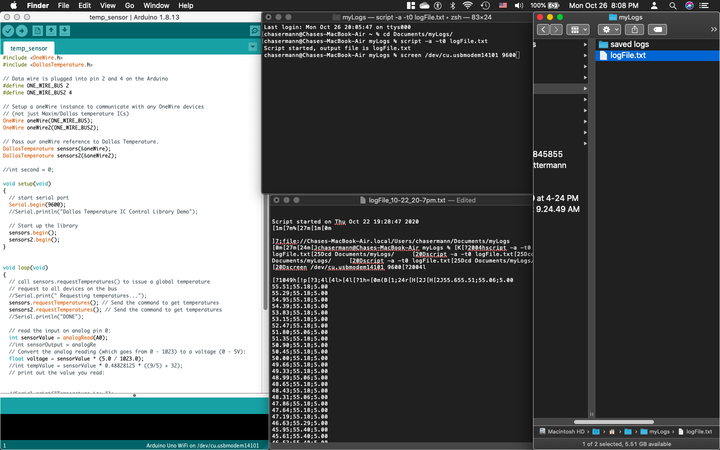
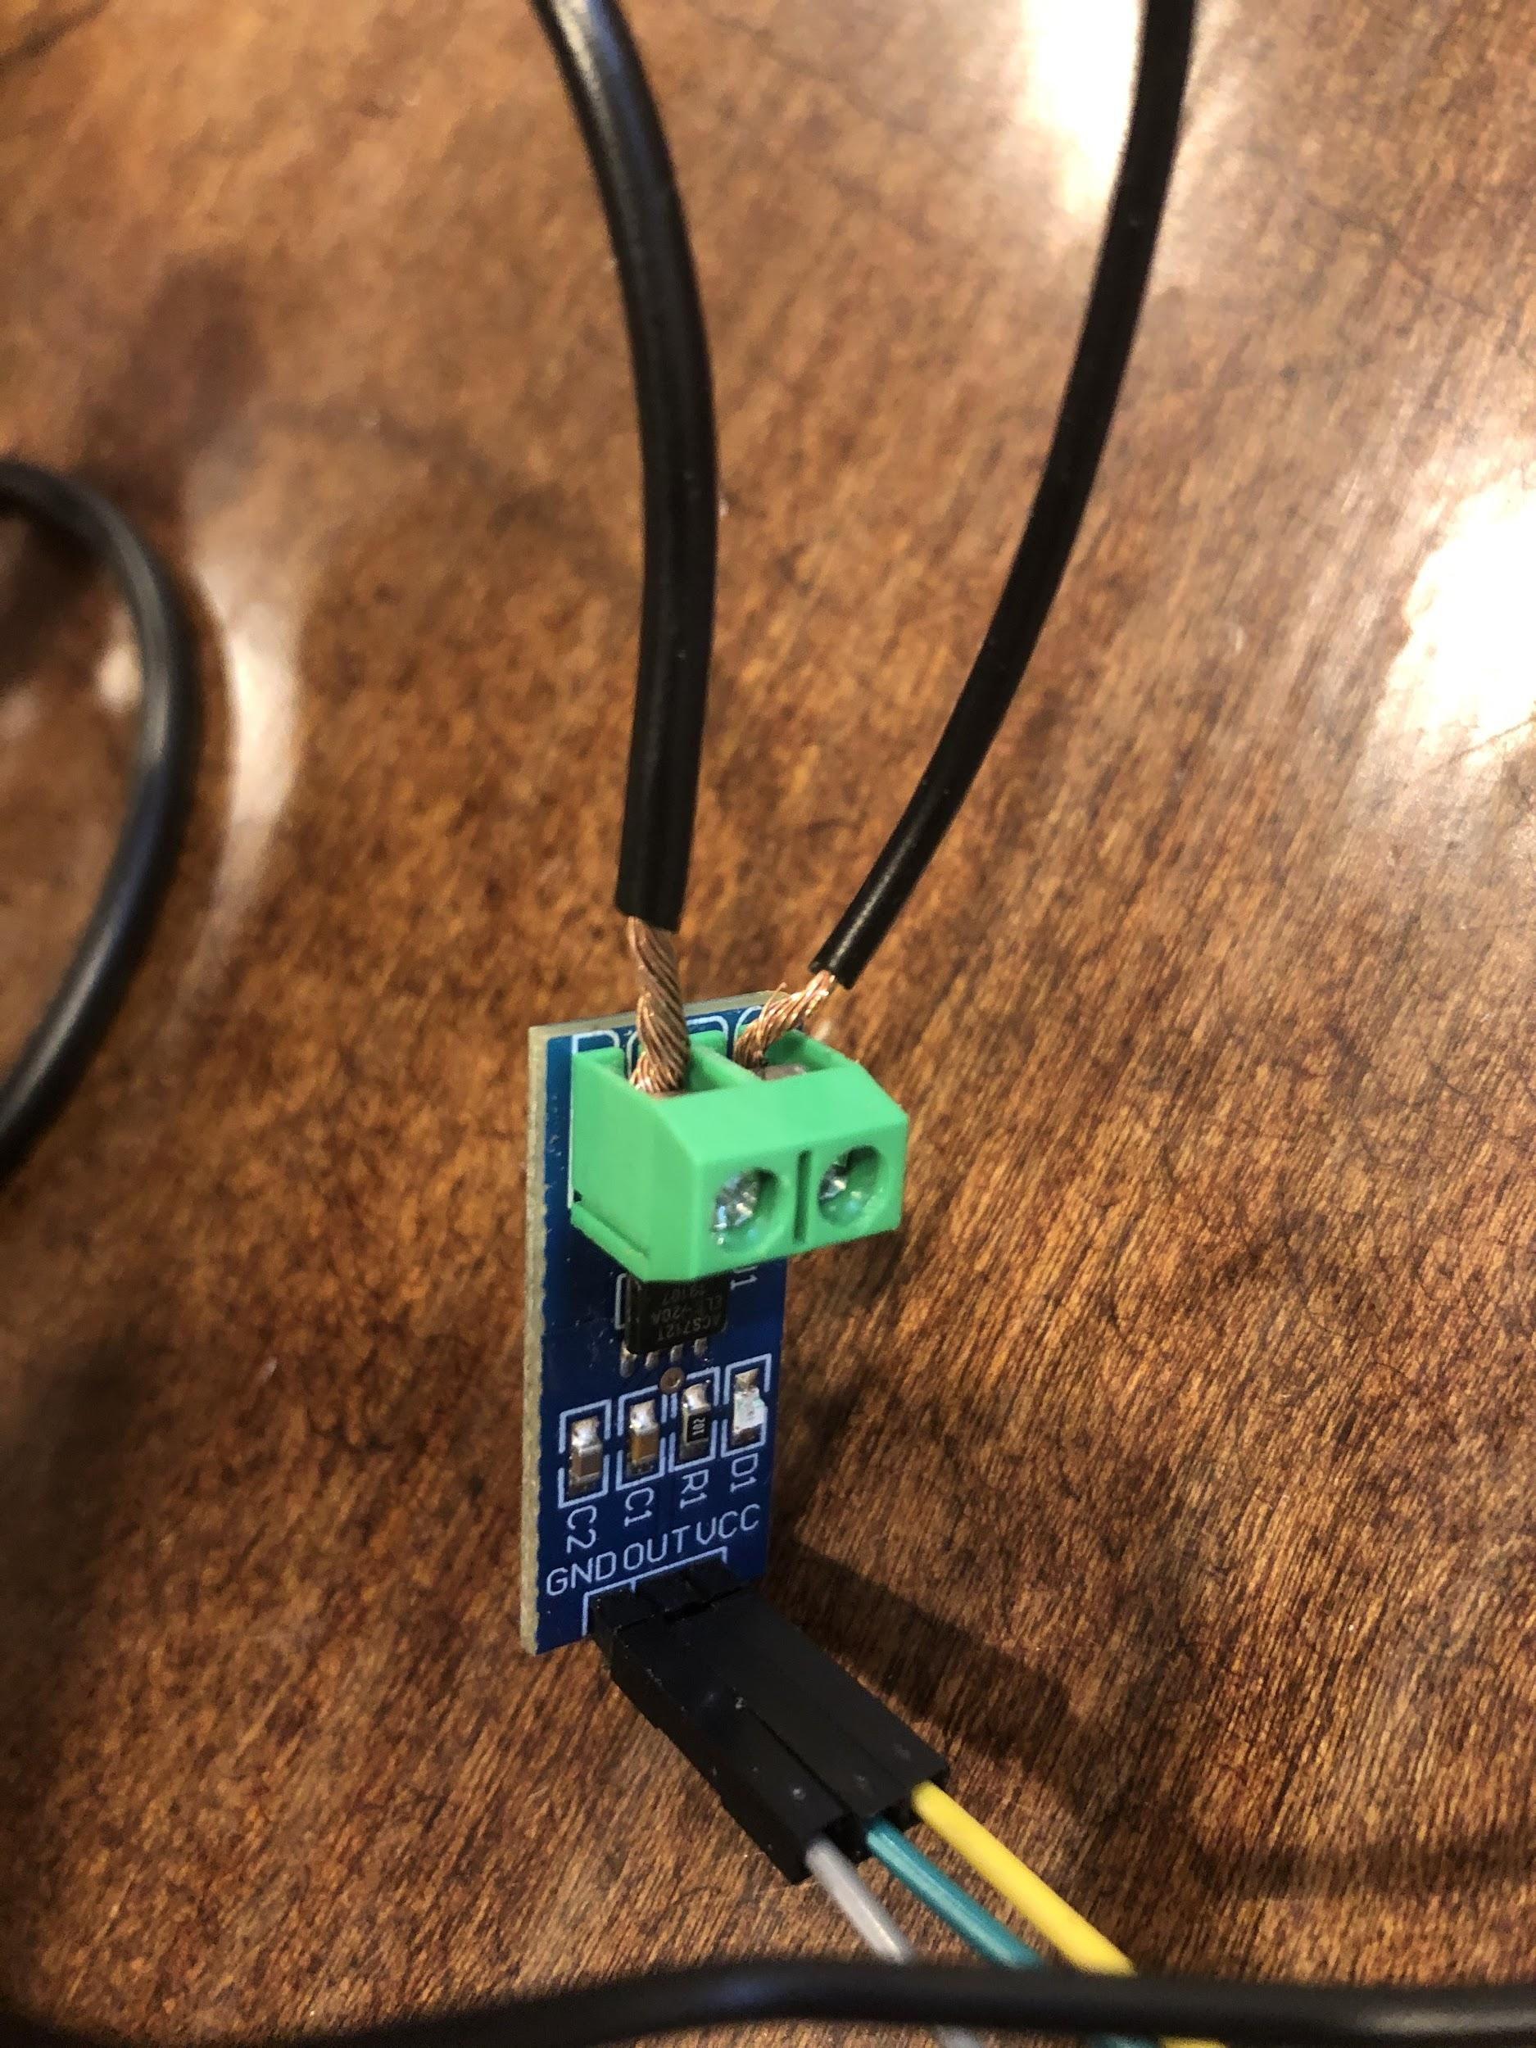
Experimental Methods:
Machine Learning, Data Clustering, Seebeck calculation
Voltage, Current and Temperature Logging with Arduino Uno, Current Sensor & Terminal (iOS)
Notes:
Taha

Slide 5
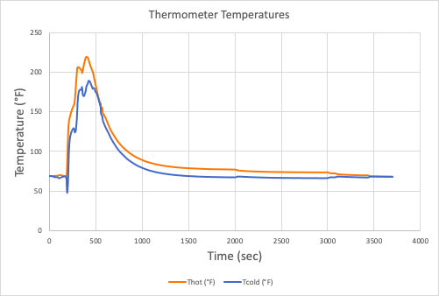
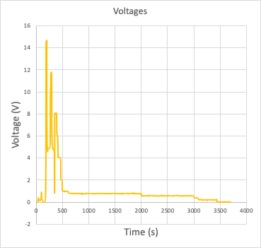
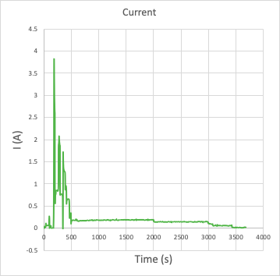
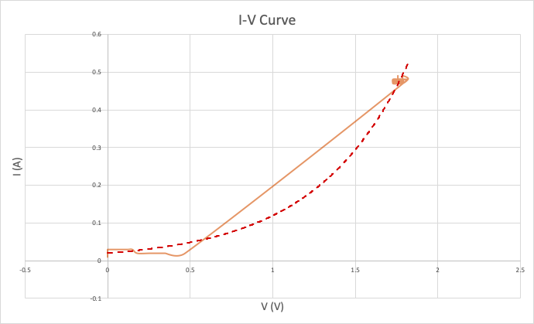
Accomplishments:
Models for thermoelectric characterization
Follows blackbody spectrum
Seebeck coefficients

Slide 6
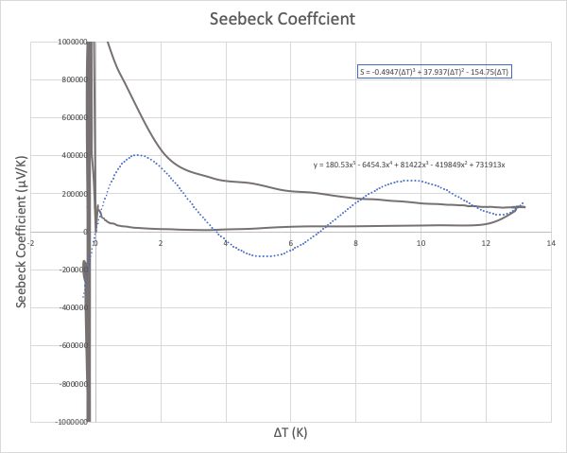
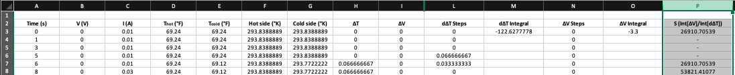
Seebeck Calculation
Time-dependent temperature difference
  Oscillating
  Converges to accurate values
  Data extrapolation
Notes:
Voltage changed immediately, whereas ΔT doesn’t => differential equation => integrate and divide
OLD: With multiple thermoelectrics the scale of thermal transfer decreases with the number of layers. So you need more and more watts to move less and less right? So maybe that's what the slide is about. Because COP of thermoelectric with ZT of 1.5 is about 15% carnot.

Slide 7
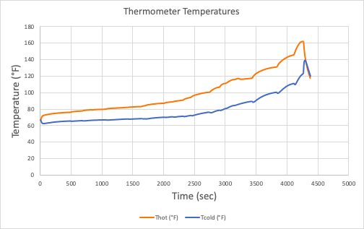
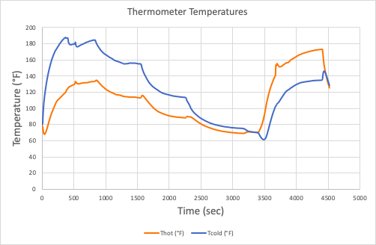
More Trials
Small power increments
2. Reversed contacts

Slide 8
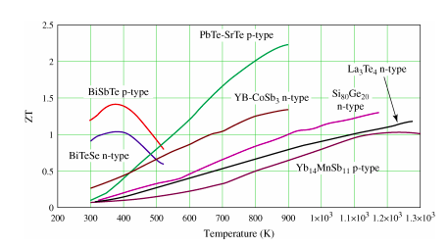
who combined melt spinning and spark plasma sintering. A ZT value of 1.5 at 400 K was found for p-type Bi0.5Sb1.5Te3
This, of course, may be an acceptable figure but it could, no doubt, be improved by orienting the grains, perhaps by extrusion.
https://www.ncbi.nlm.nih.gov/pmc/articles/PMC5453363/
https://www.nature.com/articles/s41598-020-74887-z

Slide 9
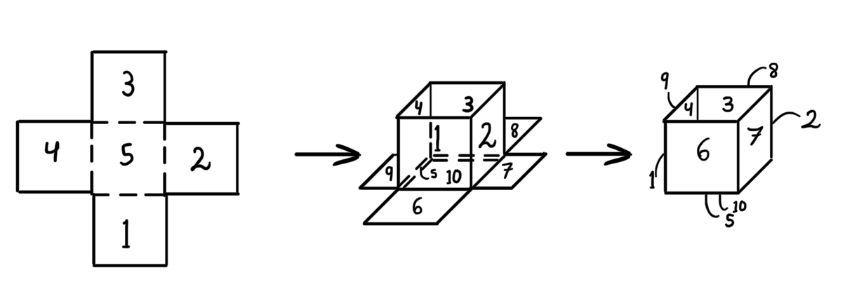
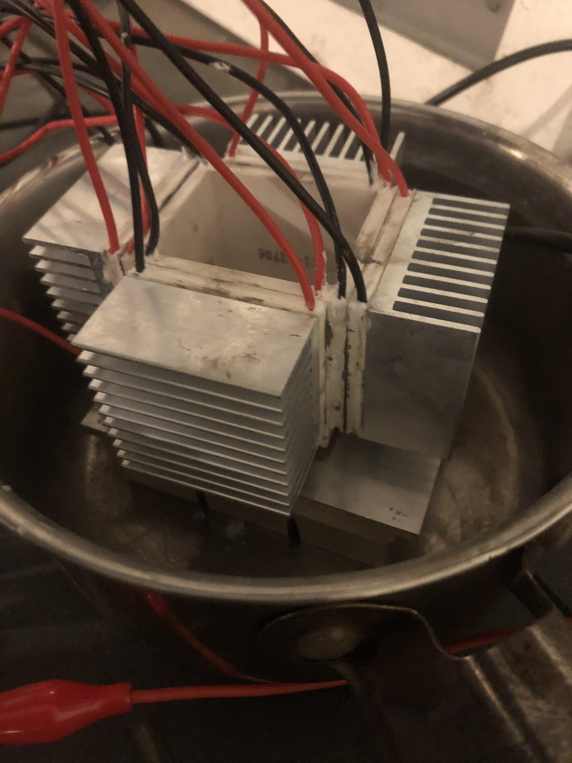
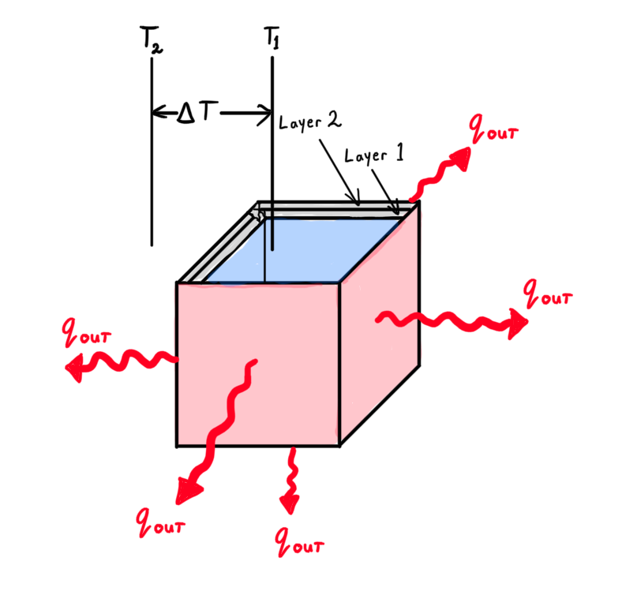
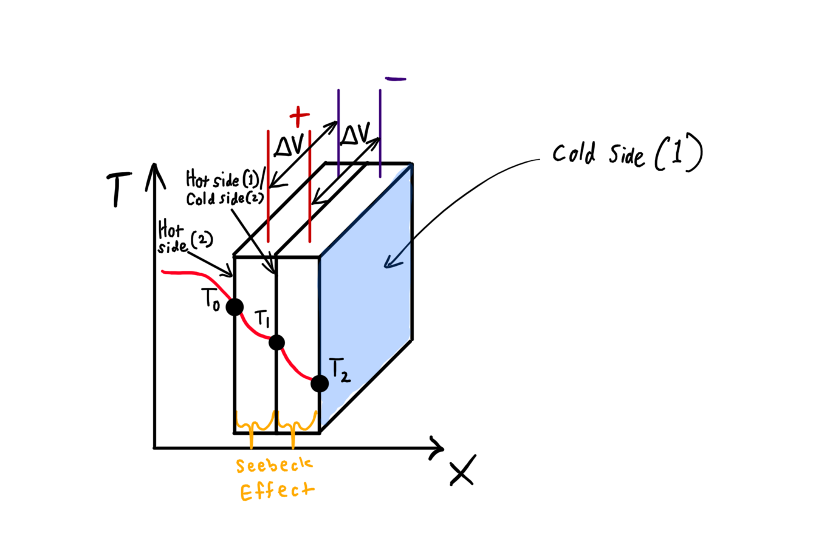
Thermoelectric Cube
10 x Thermoelectric Cooler Peltier Plates (BiTe)
Cold sides on interior / Hot sides on exterior
Double-stacked
Aluminum heat sinks
  4 x small heat sinks (sides)
  1 x large heat sink (bottom)
Thermal paste between layers
Water contact on outside and inside

Slide 10
Challenges and Solutions
Resistors burning up
  Need “Goldilocks” equivalent resistance, keeping resistor-ratio constant
Sub-freezing water not solidifying
Plate-plate and plate-radiator surface contact
Adhesive not fully cured
Climate & humidity

Slide 11
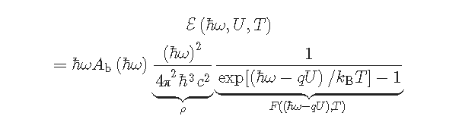
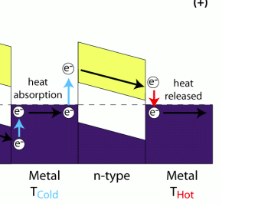
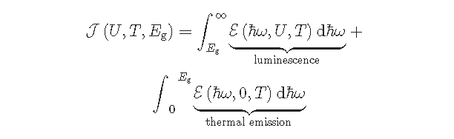
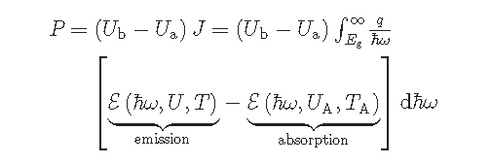
Bosons more efficient than Fermions?
Power Transfer
the Limitation of States:
Notes:
optical density of states ρ and the generalized Bose–Einstein distribution F as
The irradiance
J
J of the object, including the luminescence above the bandgap (Eg) and the thermal radiation below the gap, is consequently given by
P per unit surface area needed to drive the light emission of an LED in a lossless thermophotonic system, consisting of the emitter and the (here homogeneous) environment absorbing the radiation, is correspondingly

Slide 12
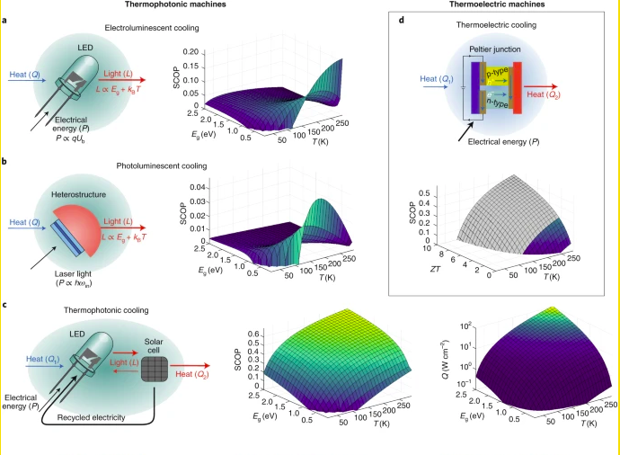

Slide 13
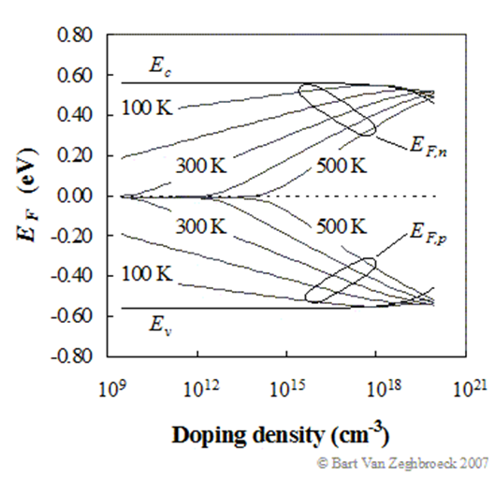
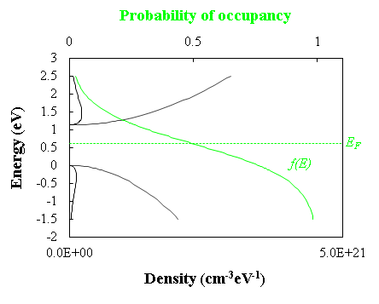

Slide 14
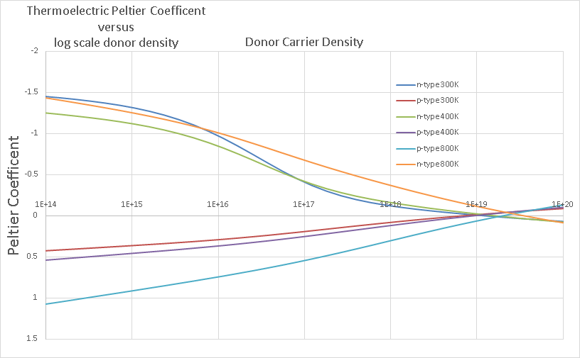

Slide 15
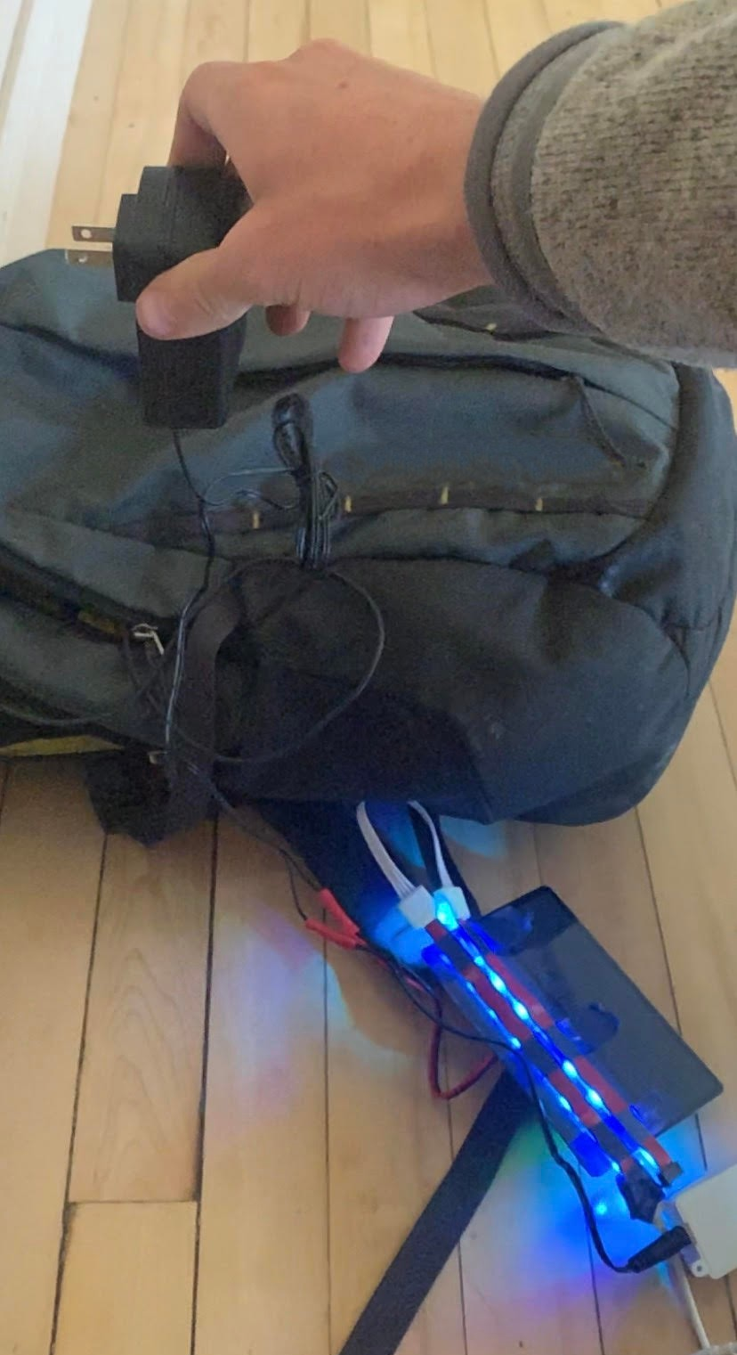
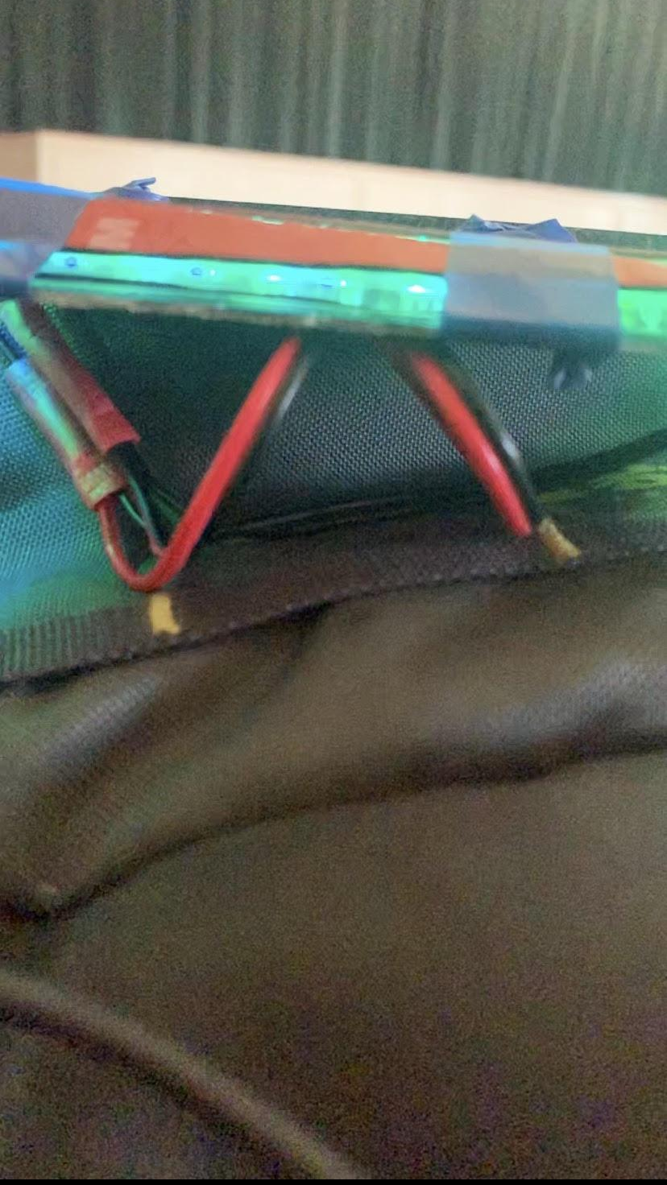
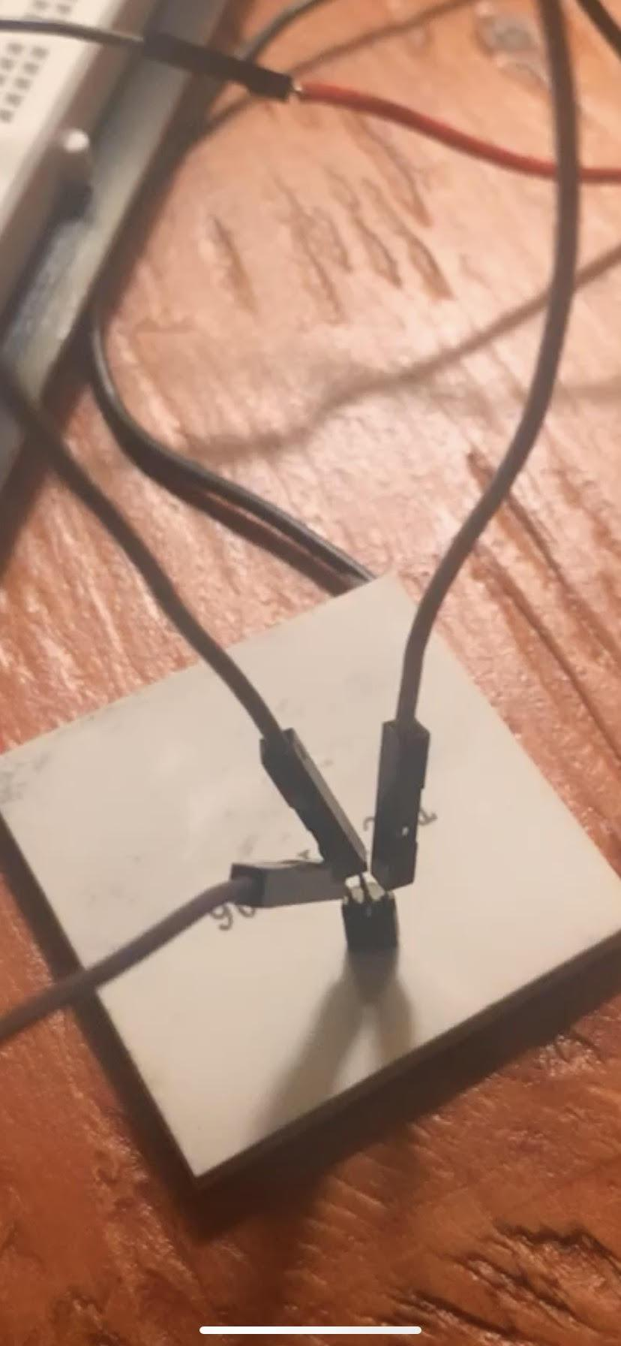
Thermal Equilibrium in Air.
0.4 S extended attenuation,
Capacitive Equivalent = ?
Band matching Red 660 nm or 1.87 eV LED 0.06W each to 1.12eV silicon absorber
Thermophotonics
0.8 Watts per C gradient in air.
2C gradient
Thermoelectrics
2 Watt per C gradient in air
70C gradient
Notes:
Zach I like this slide and it’s a good way to introduce methods of thermoelectric characterization

Slide 16
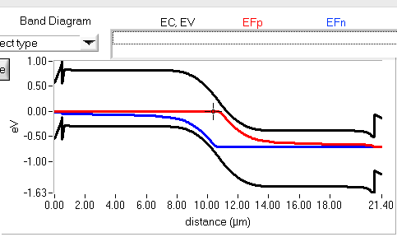
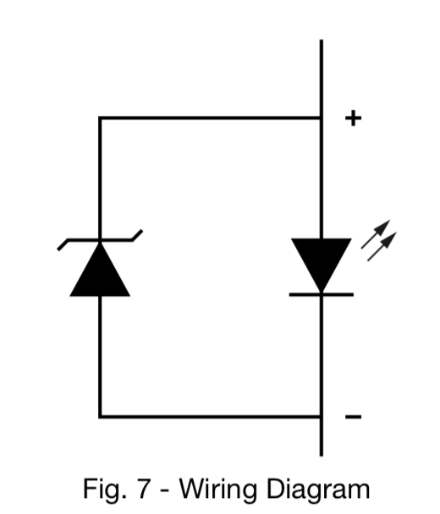
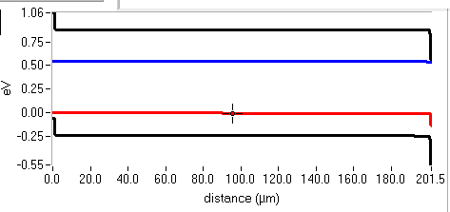

Slide 17
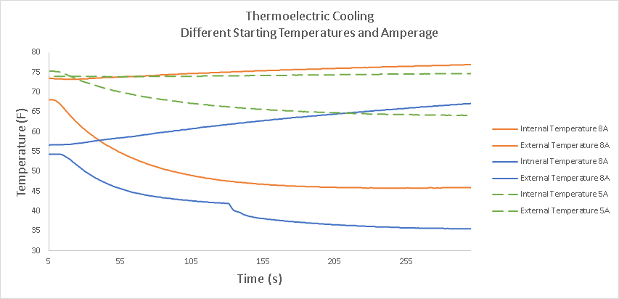
Relationships
Notes:
Linear External Temp
Logarithmic Internal Temp

Slide 18
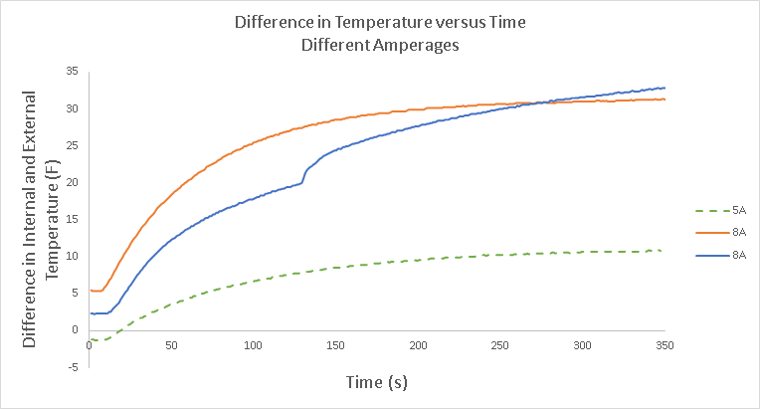

Slide 19
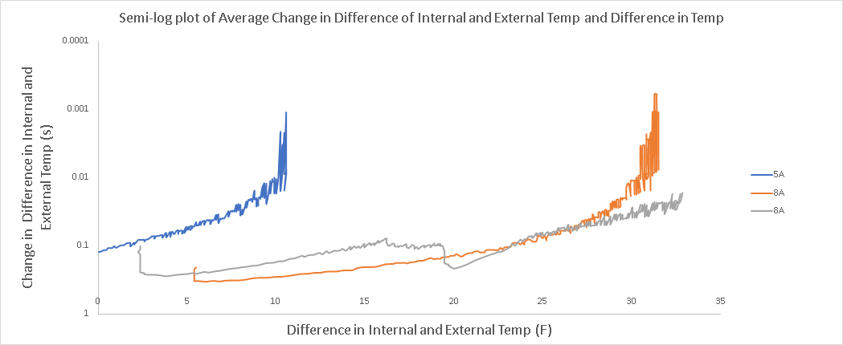
15 trials ran
I-(d^2T/dt) and I-(d^2T/dT) dependence plotted on semi-log axes
Notes:
Theoretically:
Rate of phonon flux in one direction matches rate of electron flux in the other direction as the system becomes reasonably warm and the difference in temp across a distance becomes large. Temp difference is limited by power which... the efficiency of electrons as majority thermal energy carriers drops off logarithmically with decreased power and also with large temperature once you lose thermoelectric efficiency.

Slide 20
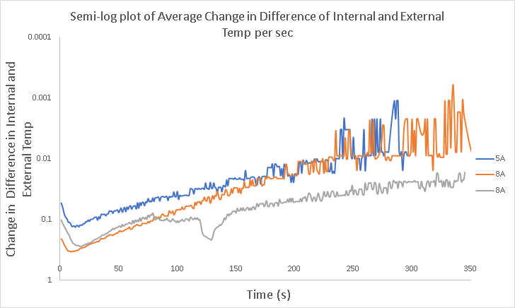

Slide 21
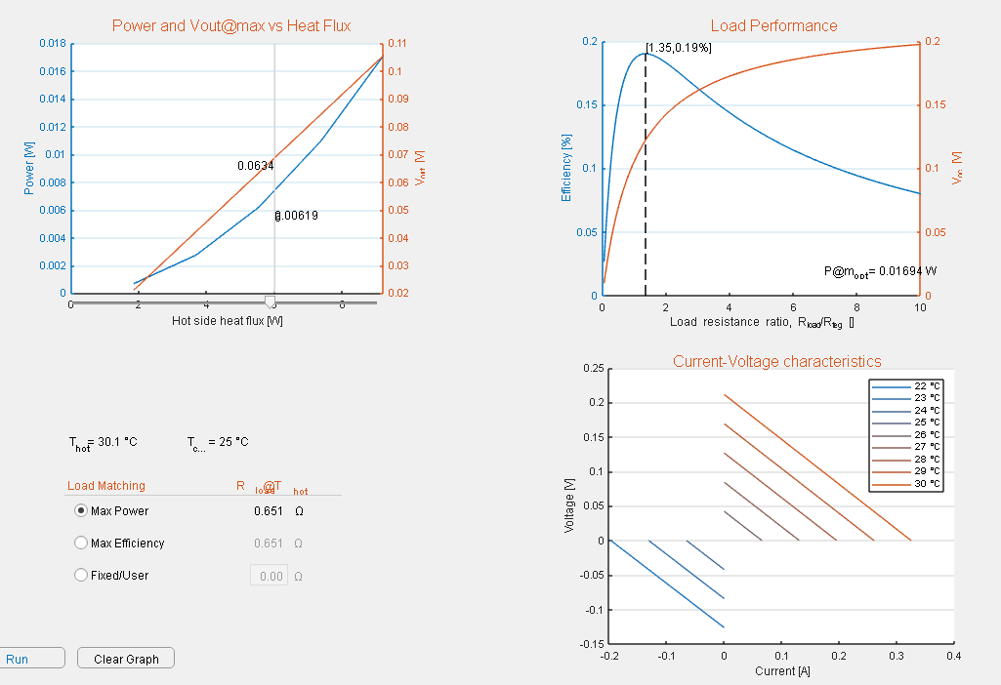
Relationships

Slide 22
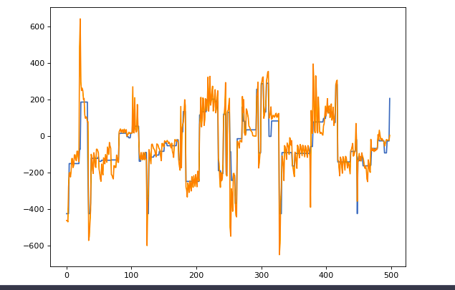
ML Accomplishments:
zT = S²σ/κT
Parity Plot
Seebecks Predicted
Seebecks Actual
Seebecks
ΔV/Δ T
R² = 0.58
Compounds in Training Dataset

Slide 23
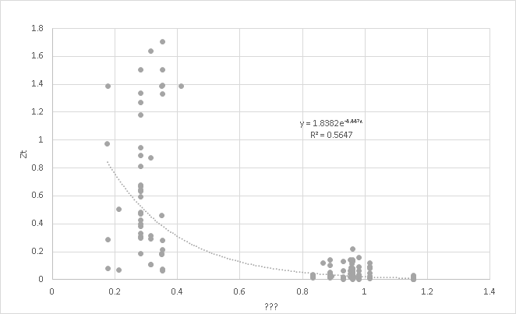
Sum of Compound Electron Valence/ Electron Shell

Slide 24
Kaggle Kernal Input & Code:
Periodic Table data
Electron configurations for each atom
Seebeck coefficients for each element
Elemental concentrations
[[1, 9, 1, 10, 3, 5]]
-419
Sc Ti 3Si
[[1, 8, 3, 9, 2, 5]]
-420
Ca 3Sc 2Si
[[1, 11, 1, 8, 3, 5]]
-402
V Ca 3Si
[[1, 8, 1, 6, 3, 4]]
-404
Ca P 3Al

Slide 25
Raw Output from Compound Generator Filter and ML
[[2, 10, 2, 6, 1, 15]]
-339 Ti P Co
[[2, 20, 1, 2, 2, 21, 3, 7]]
-362 Ge Na Se K
[[1, 2, 1, 4, 1, 20]]
-301 Na Al Ge
[[1, 14, 2, 2, 2, 20, 1, 5]]
-400 Fe Na Ge Si
[[2, 9, 2, 3, 2, 5]]
-500 Sc Mg Si
[[1, 19, 1, 2, 2, 15]]
-401 Ga Na Co
[[1, 15, 2, 3, 1, 18]]
-410 Co Mg Zn
[[1, 7, 3, 2, 2, 11]]
-419 K Na V
[[1, 17, 1, 2, 1, 21]]
-423 Cu Na Se
[[1, 10, 2, 2, 2, 15]]
-429 Ti Na Co
[[1, 7, 3, 2, 1, 5]]
-512 K Na Si
[[2, 2, 1, 3, 1, 5]]
-539 Na Mg Si
[[1, 8, 2, 2, 3, 5]]
-525 Ca Na Si
[[2, 11, 1, 3, 2, 6]]
-504 V Mg P
[[2, 3, 1, 2, 1, 4]]
-544 Mg Na Al
[[2, 10, 2, 2, 2, 6]]
-510 Ti Na P
Notes:
half heusler perovskites

Slide 26
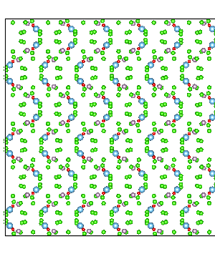
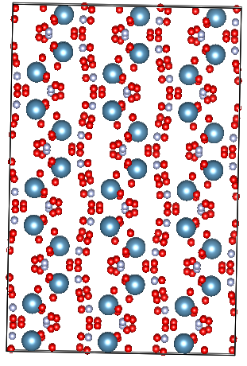
Cl 14 O2 P2 Ti2
Ca H8 N2 O10
S group elements
Heavier Elements
Larger Atomic Radius
High conductivity
Disorganized structure that dissipates phonons
Extrinsic band gap that favors phonon to electron conversion. 6kBT to 18kBT
Weyl fermions responsible for decoupling electron phonon transport
Perovskites, Skutterrites, Half Huesler

Slide 27
Why use Thermoelectrics at all?
Thermal emitters combined with thermophotovoltaics may be more efficient at the task at hand.
Want cost effective, compact device for refrigeration.
Can be used in combination with other energy systems to capture and recycle waste heat
Eliminate rogue phonons (waste heat) altogether
Notes:
Chase

Slide 28
Material Eg Seebeck (μV/K) F.o.M (ZK) T(K)
Cu2Se 0.076eV -200S 1.51 ZT 1000K
Ag2Se 0.09eV 407S 1.20 ZT 300K
Zr0.5Hf0.5Sn 0.13eV -123S 1.40 ZT 300K
NaₓPbTe 0.32eV -374S 2.27 ZT 700K
Bi2Te3 0.14eV 225S 0.98 ZT 300K
SnₓSb2Se3 0.49eV ? ? 800K
Zn4Sb3 0.56eV 14S 1.28 ZT 1000K
InₓCo3Sb12 0.58eV 144S 1.50 ZT 700K
SnSe 1.34eV 2.30 ZT 1000K
Notes:
Taha (slides 1, 2, 28, 29, and Characterization slides at the end)
Bi2Te3 is trigonal
Sb2Se3 is

Slide 29
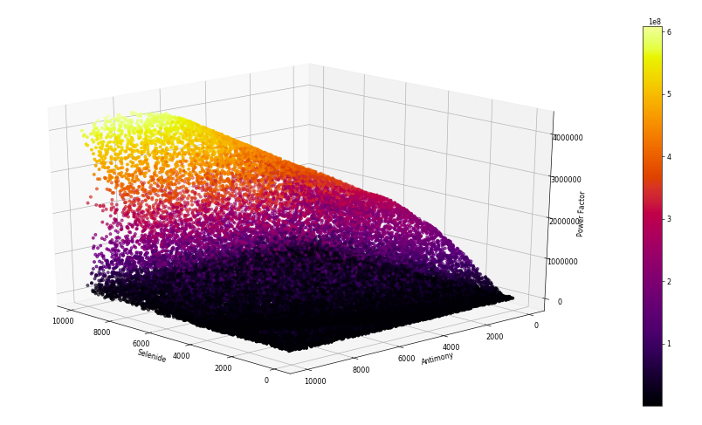

Slide 30
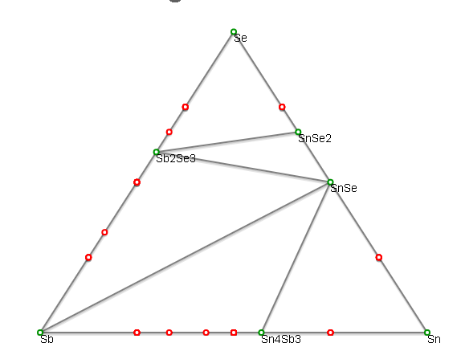
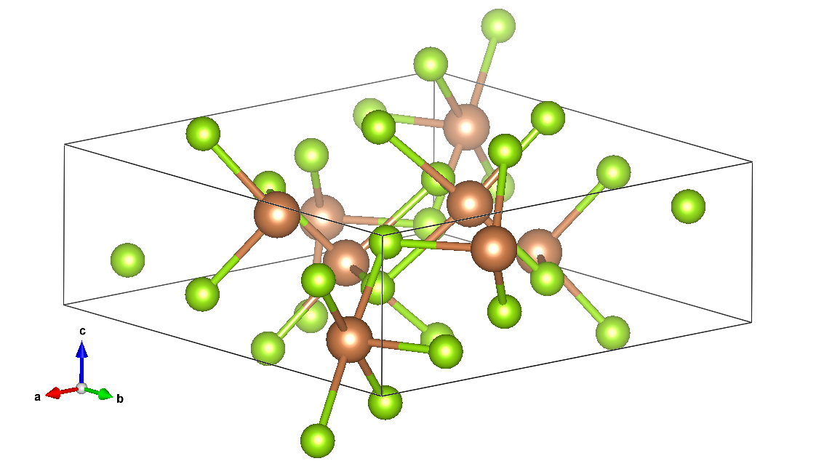
Sb₂Se₃
High theoretical Seebeck & zT
Energy of formation
Novel
Economically viable
Efficient synthesis
Notes:
Machine learning predicted high values for Seebeck coefficient and figure of merit
Crystal structure known and thermodynamically stable with low Gibbs energy of formation; phases consistent even with Sn doping!
Not much research on Sb2Se3 for thermoelectrics and tuning BG (doping)
Cheap and inexpensive materials for quick synthesis (<1 hour)

Slide 31
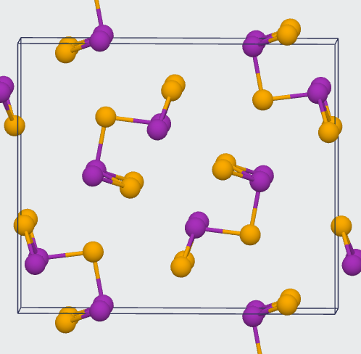
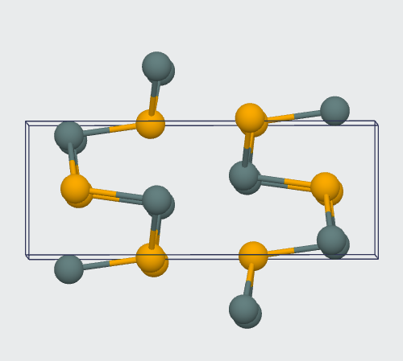
SbSe
SnSe

Slide 32
Ga2Se3Sn0.2Ca
Sb2Se3Sn0.2Ca
Sb2Se3 ~0.49eV and Ga2Se3 ~0.53eV,

Slide 33
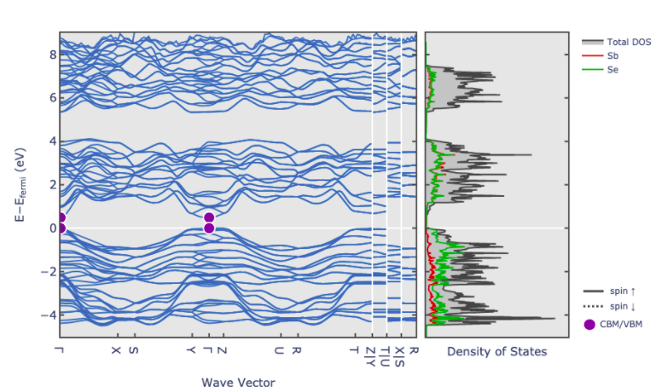
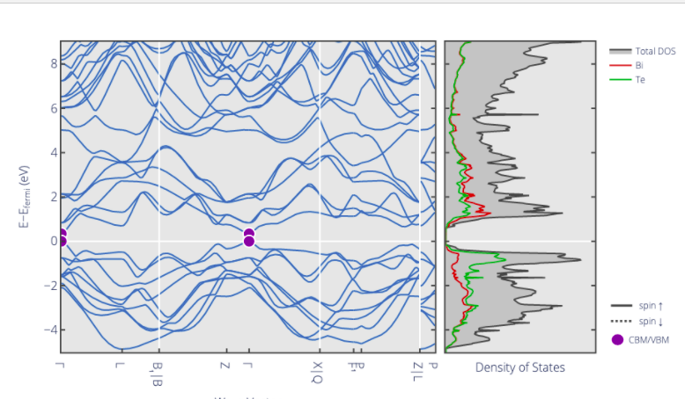
Quantum states
Sb2Se3
BiTe

Slide 34
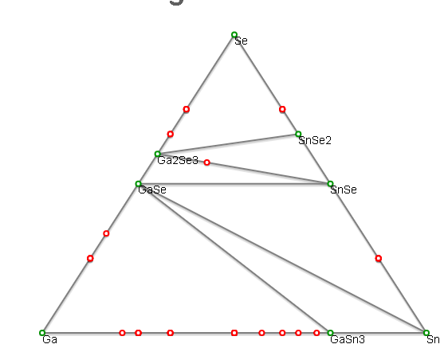
Gibbs Energy of Formation

Slide 35
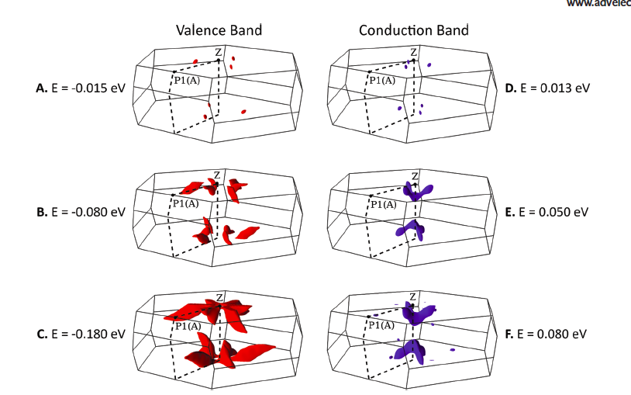
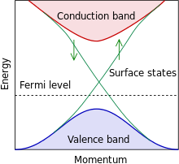
Thermoelectrics are Topological Insulators?

Slide 36

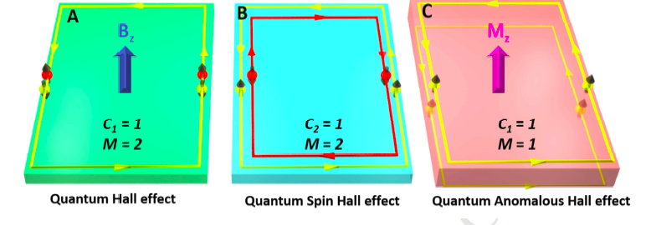
Dirac Semi-Metals

Slide 37
INFRARED
ELECTRON

Slide 38

Pygra
Hamiltonian - Fermi
Physics Simulation

Slide 39

R:
Python:
Notes:
So thermoelectrics are topological insulators, but what is a topological insulator anyway? Basically you need semi metals with ultra small band gaps/inversions with ultra high symmetry in 3-D. This inversion creates a much more textured and unique electron band state. By conducting electrons only at the surface states and creating a highly 2-D nanoscopic crystalline structure we limit phonons through the bulk of the material. It's sort of like a hydrophilic material for electrons.
Topological hall effect induces inverted electron spin and this Isosymmetirac polarization of fermions dictates their favorability as a transport carrier. This inversion has two important sysmetries, (time and momentum) Momentum is symmetrical but time is not, berry curvature thus defines this relationship and an unequal particle relationship occurs because of this.

Slide 40



Slide 41


Review of Quantum Hall Trio Xufeng Kou, Yabin Fan, Kang L. Wang 2017:

Slide 42


Slide 43

Chemicals
Antimony(III) acetate (Sb(CH3COO)3, 99.99%),
Antimony(III) chloride (SbCl3, >99%),
Sodium(II)Selenate(III) (Na2SeO3 >99.99%)
25% Hydrazine hydrate (N2H2•H2O)
Notes:
State mateirals
Reasons for both Sb (synthesis 1 and 2)
Acetate cheaper

Slide 44
Synthesis Methodology
Chemical synthesis
Antimony (III) Acetate
2Sb(CH3COO)3(aq) + 3Na2SeO3(aq) + N2H4•H2O → Sb2Se3(s) + N2 + H2O + 6Na⁺ + 6Ch3COO⁻ + NH3
Antimony (III) Chloride
2SbCl3(aq) + 3Na2SeO3(aq) + N2H4•H2O → Sb2Se3(s) + N2 + H2O + 6Na⁺ + 6Cl⁻ + NH3
N2H4
N2H4
Notes:
2.1. Synthesis
All chemicals were of analytical grade and were used as received. All glassware were acid-cleaned, and the ultrapure water was devoid of any trace of organics. The synthesis of Sb2Se3 is performed by a new redox method using antimony acetate and/or chloride salts, sodium selenite, hydrazine hydrate (N2H4H2O), and/or permanganate in neutral and basic aqueous solution, respectively. For the first reaction, Sb(CH3COO)3 (0.227 g, 0.750 mmol) and Na2SeO3 (0.259 g, 1.49 mmol) were weighted independently and then placed together into a 50 mL volumetric flask followed by the addition of 25 mL of pure water at room temperature. It is important to dissolve all the salts simultaneously via sonication to obtain the results desired. After the salts were completely dissolved, 3 mL of 80% hydrazine hydrate and NaOH (0.01 mol, pH = 10) is added dropwise to the solution followed by dilution to the 50 mL mark with pure water and then placed in a sonicator bath at 40°C for 40 min. After the addition of hydrazine, the solution turned turbid, and a white/beige precipitate appeared, which rapidly settled down, leaving a colorless solution. The solids are separated by filtration (Whatman filter paper) and washed with ethanol and pure water, followed by air drying at room temperature for characterization. The first reaction is summarized as
Note that we run the above reaction in the absence of NaOH as well. Since there were no noticeable differences in the color of the product with and without NaOH, we proceeded to change the salt type of the reaction. The only difference observed was in the amount of solids produced which were more in the presence of NaOH.
For the second reaction, the above process was repeated, except that SbCl3 was used in place of Sb(CH3COO)3 with no NaOH, to study the effect of salt type and pH on the reaction. In this case, the solids produced are black:
For the third reaction, the above process (reaction 1) is also repeated with minor changes; SbCl3 is used in place of Sb(CH3COO)3; KMnO4 is used together with hydrazine and NH3 in place of NaOH. The pH of this mixture was around 10. The solids produced are a mixture of reddish brown and black in color:
The pH of the permanganate solution was near neutral and unstable (reacts with water). The addition of NH3 (weak base) made the solution basic and stable. At this pH, the permanganate solution is purple and stable and the manganese is mostly Mn(VII).

Slide 45



Synthesis Methods:
Notes:
2.1. Synthesis
All chemicals were of analytical grade and were used as received. All glassware were acid-cleaned, and the ultrapure water was devoid of any trace of organics. The synthesis of Sb2Se3 is performed by a new redox method using antimony acetate and/or chloride salts, sodium selenite, hydrazine hydrate (N2H4H2O), and/or permanganate in neutral and basic aqueous solution, respectively. For the first reaction, Sb(CH3COO)3 (0.227 g, 0.750 mmol) and Na2SeO3 (0.259 g, 1.49 mmol) were weighted independently and then placed together into a 50 mL volumetric flask followed by the addition of 25 mL of pure water at room temperature. It is important to dissolve all the salts simultaneously via sonication to obtain the results desired. After the salts were completely dissolved, 3 mL of 80% hydrazine hydrate and NaOH (0.01 mol, pH = 10) is added dropwise to the solution followed by dilution to the 50 mL mark with pure water and then placed in a sonicator bath at 40°C for 40 min. After the addition of hydrazine, the solution turned turbid, and a white/beige precipitate appeared, which rapidly settled down, leaving a colorless solution. The solids are separated by filtration (Whatman filter paper) and washed with ethanol and pure water, followed by air drying at room temperature for characterization. The first reaction is summarized as
Note that we run the above reaction in the absence of NaOH as well. Since there were no noticeable differences in the color of the product with and without NaOH, we proceeded to change the salt type of the reaction. The only difference observed was in the amount of solids produced which were more in the presence of NaOH.
For the second reaction, the above process was repeated, except that SbCl3 was used in place of Sb(CH3COO)3 with no NaOH, to study the effect of salt type and pH on the reaction. In this case, the solids produced are black:
For the third reaction, the above process (reaction 1) is also repeated with minor changes; SbCl3 is used in place of Sb(CH3COO)3; KMnO4 is used together with hydrazine and NH3 in place of NaOH. The pH of this mixture was around 10. The solids produced are a mixture of reddish brown and black in color:
The pH of the permanganate solution was near neutral and unstable (reacts with water). The addition of NH3 (weak base) made the solution basic and stable. At this pH, the permanganate solution is purple and stable and the manganese is mostly Mn(VII).

Slide 46

Dopants
A trace of impurity
N-type
P-type
Proper types and amounts

Slide 47

Counter and Resonant doping
Lowering the threshold voltage
Insert more than one type of ion
The extra electron and the extra
Whole cancel out
Resonant doping

Slide 48


Slide 49


Slide 50


Slide 51


Addition of Hydrazine and Sonicated for 30 minutes:
Notes:
We added the same amounts of

Slide 52



Addition of
3ml 0.1 mol NaOH yielded white precipitate:
Strictly
3-5ml Hydrazine yields dark red/black precipitate:

Slide 53

Pros:
Highly homogeneous
particle grain size
Cons:
Nanorods structures are mostly absent
Notes:
Sputter with 5 um of gold

Slide 54


Pros: Little Trace Contamination
Cons: Presence of Oxygen

Slide 55


Create Greenbody
10 MPA for 2 minutes:

Slide 56

Sealing in Quartz Ampule:
Isolate Material in Argon

Slide 57


Heating in Tube Furnace to 610 C

Slide 58


Slide 59

For SbSe:
Resonant Dopant:
Ge
Point Defect Dopant:
Na, Mg
Acceptor:
Sn

Slide 60

Selecting our dopant

Slide 61

Characterization
Material characterization
XRD
SEM
Thermoelectric characterization
Potential and current applied
V-I-ΔT analysis
  Calculation of S and zT
Notes:
Taha *note we haven’t done this yet*
XRD for crystallography and verification of our synthesis
SEM for optical properties, grain boundaries, etc.
Applied voltage/current from power supply and measured difference in temperature between the ends of the Sb2Se3 pellets
Data will be logged with multimeter in lab, as well as a custom Arduino-based device which measures current, voltage, and temperature simultaneously
Seebeck coefficients and figure of merit were calculated from V / ΔT data

Slide 62
References
Liang, G., Chen, X., Tang, R., Liu, Y., Li, Y., Luo, P., ... & Chen, S. (2020). Spark plasma sintering of Sb2Se3 sputtering target towards highly efficient thin film solar cells. Solar Energy Materials and Solar Cells, 211, 110530.
Hu, N., Cheney, M. A., Hanifehpour, Y., Joo, S. W., & Min, B. K. (2017). Synthesis, characterization, and catalytic performance of Sb2Se3 nanorods. Journal of Nanomaterials, 2017.
Xie, D., Zhang, B., Zhang, A., Chen, Y., Yan, Y., Yang, H., ... & Zhou, X. (2018). High thermoelectric performance of Cu 3 SbSe 4 nanocrystals with Cu 2− x Se in situ inclusions synthesized by a microwave-assisted solvothermal method. Nanoscale, 10(30), 14546-14553.
Goldsmid, H. J. (2014). Bismuth telluride and its alloys as materials for thermoelectric generation. Materials, 7(4), 2577-2592.
Lü, X. L., Xie, Y., & Xie, H. (2018). Topological and magnetic phase transition in silicene-like zigzag nanoribbons. New Journal of Physics, 20(4), 043054.
Witting, I. T., Chasapis, T. C., Ricci, F., Peters, M., Heinz, N. A., Hautier, G., & Snyder, G. J. (2019). The thermoelectric properties of bismuth telluride. Advanced Electronic Materials, 5(6), 1800904.
Xin, J., Tang, Y., Liu, Y., Zhao, X., Pan, H., & Zhu, T. (2018). Valleytronics in thermoelectric materials. npj Quantum Materials, 3(1), 1-10.
Kou, X., Fan, Y., & Wang, K. L. (2019). Review of quantum Hall trio. Journal of Physics and Chemistry of Solids, 128, 2-23.
Wang, L., Cai, K. F., Wang, Y. Y., Li, H., & Wang, H. F. (2009). Thermoelectric properties of indium-filled skutterudites prepared by combining solvothermal synthesis and melting. Applied Physics A, 97(4), 841-845.
Aliabad, H. R., & Rad, F. A. (2018). Structural, electronic and thermoelectric properties of bulk and monolayer of Sb2Se3 under high pressure: By GGA and mBJ approaches. Physica B: Condensed Matter, 545, 275-284.
Doert, T., & Böttcher, P. (1994). Crystal structure of bismuth nonathallium hexatelluride, BiTl~ 9Te~ 6. Zeitschrift fur Kristallographie, 209(1), 95-95.
Tideswell, N. W., Kruse, F. H., & McCullough, J. D. (1957). The crystal structure of antimony selenide, Sb2Se3. Acta Crystallographica, 10(2), 99-102.
Lange, P. W. (1939). Ein Vergleich zwischen Bi 2 Te 3 und Bi 2 Te 2 S. Naturwissenschaften, 27(8), 133-134.

